Slide 1
SAP HANA on Azure Whiteboard Design Session (Trainer Deck)
Trainer names

Slide 2
Abstract and learning objectives
Abstract :
In this workshop, you will look at what is involved in deploying SAP HANA on Azure with the goals of designing for in-memory database performance, business continuity and flexibility as well as fully optimized total cost of ownership. At the end of this workshop, you will be able to better design, price and present SAP HANA on Azure solutions to your customers.
Learning objectives :
Design SAP HANA workloads on Azure in alignment with SAP HANA certification with high availability and disaster recovery.
Run Azure Pricing Calculator to price the SAP HANA landscape.
Present the solution to business/technical decision makers and handle Q&A with customer.
Prerequisite :
R-AIT344 : Architecture deep dive for SAP deployments
R-AIT333 : SAP Migration Practitioner Panel
Understanding of SAP on Azure Webinar Training and S/4HANA on Azure reference architecture

Slide 3
Step 1: Review the customer case study
Outcome
Analyze your customer needs
Timeframe
10 minutes

Slide 4
Customer situation : Contoso Group
Contoso Group is a pharmaceutical company with its headquarters based in Boston, US.
Contoso Leadership and Planning Groups wants to drastically reduce server and storage hardware in their own datacenters to minimize IT related costs. Contoso has already a number of their non-SAP systems migrated to Azure. The leadership asked Contoso IT to look into the possibility to deploy its green field S/4HANA environment to cloud.
Contoso IT decided to leverage its knowledge of the Microsoft cloud platform and existing ExpressRoute connectivity and host its SAP S/4HANA landscape in Azure.
Considering that Contoso finance and supply chain team will strongly rely on S/4HANA, the systems should be highly available and their performance must be predictable and consistent. In addition, the management team wants to leverage disaster recovery capabilities offered by Azure in order to ensure resiliency in case the primary region hosting the new deployment becomes unavailable.
Before migrating the production environment, Contoso wants to test its new deployment approach by provisioning development, and UAT environments in Azure.

Slide 5
Contoso CIO Vision
“Our operational dependencies on SAP applications force us to seek reasonably priced high availability and disaster recovery capabilities for our production SAP S/4HANA deployments.”
Andrew Cross, CIO, Contoso Group

Slide 6
Contoso S/4HANA Deployment Priorities
In-memory database performance and agility to scale
High Availability & Disaster Recovery
Data protection & security
Safe and smooth migration
IT standardization across SAP and non-SAP
1
2
3
4
5

Slide 7
Contoso S/4HANA Requirements
Contoso’s requirements to size its S/4HANA with HA, DR and data protection and retention are as below.
 | HANA DB RAM requirement | Application SAPS requirement (SAPS) | High Availability for DB, application and file-share | Disaster Recovery for DB, application and file-share) | DB backup and retention period
Production | 2TiB | 15,000 | Required (No data loss, 99.95%+ VM uptime) | Required | Log backup every 30min retained for 1 day, Full daily backup for 1 month
Quality Assurance | 2TiB | 15,000 | Required (Same as Prod) | No | Full bi-weekly backup for 1 month
Development | 192GiB | No | No | No | Full bi-weekly backup for 1 month

Slide 8
Discuss key design concepts (15 minutes)

Slide 9

SAP on Azure – A wide variety on Compute instances
NetWeaver Certified
NetWeaver certified and HANA certified soon
NetWeaver and
HANA certified
NetWeaver Certified and HANA certified
SAP HANA certified
A
D
F
G
Ev3
M
A
Av2
Dv2
Dv3
G
General purpose
workloads
Compute intensive
workloads
Memory optimized for Dev/Test & PoC HANA workloads
Memory optimized for Dev/Test & PoC HANA workloads
Optimized for large production SAP HANA workloads
Purpose built instance for largest SAP HANA production workloads
HIGHEST VALUE
LARGEST SCALE-UP
vCPUs
 |  |  | 2 – 64 | 2 – 64 |  | 32 – 208 (416 in roadmap) | 96 - 768
 |  |  | 8 - 256 | 16 - 432 |  | 192 – 5700 (11.40 TiB in roadmap) | 768 – 24576
 |  |  | 69,680 | 70,050 |  | 259,950 (500k in roadmap) | 786,100
RAM (GiB)
Max SAPS

Slide 10
Pick Azure Compute for HANA and Application Servers
Choose right Azure Compute based on :
Scenario (OLTP or OLAP)
OLTP : S/4HANA, Business Suite on HANA, NetWeaver
OLAP : BW on HANA, BW/4HANA, Enterprise DWH, Sidecar
Required RAM for HANA and SAPS for application servers
 | Prod or Non-Prod | HANA scenario | HANA DB/RAM size | Select Compute based on RAM size required for HANA server(s) | Select Compute based on SAPS required for SAP application servers
1 | Dev and Test | OLTP, OLAP | - | E v3 or M Series VM | D v3 Series VM – scale out
2 | Production | OLTP | 192GiB to 6TiB | M Series VM - scale up
3 | Production | OLAP | 192GiB to 3TiB | M Series VM – scale up
4 | Production | OLTP | 6 to 24TiB | HANA Large Instances – scale up
5 | Production | OLAP | 3 to 4TiB | HANA Large Instances – scale up
6 | Production | OLAP | 4 to 60TiB | HANA Large Instances – multiple nodes Scale out up to 16 nodes

Slide 11
Choose Azure VM types to meet sizing requirements
Red : HANA certification in roadmap
VM Series | VM Type | VM Size | Temp SSD | SAPS | # of v-disks | Max IOPS (cached) | Max Disk Bandwidth (cached) | Max Network Bandwidth | Compute (No OS) hourly on demand, USE2 | Supported HANA scenarios | Remark | SAP certification
DS v3 | D2s_v3 | 2 vCPU, 8 GiB | 16 GiB | 2,178 | 4 | 4,000 | 32 MB/sec | moderate | $ 0.110 |  | Xeon E5-2673 v4 (Broadwell) 3.5Ghz TB | Certified (Any DB, App)
 | D4s_v3 | 4 vCPU, 16 GiB | 32 GiB | 4,355 | 8 | 8,000 | 64 MB/sec | moderate | $ 0.220
 | D8s_v3 | 8 vCPU, 32 GiB | 64 GiB | 8,710 | 16 | 16,000 | 128 MB/sec | high | $ 0.440
 | D16s_v3 | 16 vCPU, 64 GiB | 128 GiB | 17,420 | 32 | 32,000 | 256 MB/sec | high | $ 0.880
 | D32s_v3 | 32 vCPU, 128 GiB | 256 GiB | 34,840 | 32 | 64,000 | 512 MB/sec | extremely high | $ 1.760
 | D64s_v3 | 64 vCPU, 256 GiB | 512 GiB | 69,680 | 32 | 128,000 | 1024 MB/sec | extremely high | $ 3.520
ES v3 | E2s_v3 | 2 vCPU, 16 GiB | 32 GiB | 2,178 | 4 | 4,000 | 32 MB/sec | 1 Gbps | $ 0.146 |  | Xeon E5-2673 v4 (Broadwell) 3.5Ghz TB | Certified (Any DB, App)
 | E4s_v3 | 4 vCPU, 32 GiB | 64 GiB | 4,355 | 8 | 8,000 | 64 MB/sec | 2 Gbps | $ 0.293
 | E8s_v3 | 8 vCPU, 64 GiB | 128 GiB | 8,710 | 16 | 16,000 | 128 MB/sec | 4 Gbps | $ 0.585
 | E16s_v3 | 16 vCPU, 128 GiB | 256 GiB | 17,420 | 32 | 32,000 | 256 MB/sec | 8 Gbps | $ 1.170 |  | Xeon E5-2673 v4 (Broadwell) 3.5Ghz TB | HANA certification in roadmap App, Any DB certified
 | E32s_v3 | 32 vCPU, 256 GiB | 512 GiB | 34,840 | 32 | 64,000 | 512 MB/sec | 16 Gbps | $ 2.341 | OLTP/OLAP
 | E64s_v3 | 64 vCPU, 432 GiB | 864 GiB | 70,050 | 32 | 128,000 | 1024 MB/sec | 30 Gbps | $ 4.412 | OLTP/OLAP
M | M32ts | 32 vCPU, 192 GiB | 1,000 GiB | 33,670 | 16 | 40,000 | 400 MB/sec | 8 Gbps | $ 2.707 | OLTP | Intel® Xeon® E7-8890 v3 (Haswell) | HANA, App, Any DB certified
 | M32ls | 32 vCPU, 256 GiB | 1,000 GiB | 33,300 | 16 | 40,000 | 400 MB/sec | 8 Gbps | $ 2.873 | OLTP
 | M64ls | 64 vCPU, 512 GiB | 2,000 GiB | 66,600 | 32 | 80,000 | 800 MB/sec | 16 Gbps | $ 5.415 | OLTP
 | M64s | 64 vCPU, 1,024 GiB | 2,000 GiB | 67,315 | 32 | 80,000 | 800 MB/sec | 16 Gbps | $ 6.669 | OLTP/OLAP
 | M64ms | 64 vCPU, 1,792 GiB | 2,000 GiB | 68,930 | 32 | 80,000 | 800 MB/sec | 16 Gbps | $ 10.337 | OLTP
 | M128s | 128 vCPU, 2,048 GiB | 4,000 GiB | 134,630 | 64 | 160,000 | 1,600 MB/sec | 30 Gbps | $ 13.338 | OLTP/OLAP
 | M128ms | 128 vCPU, 3,800 GiB | 4,000 GiB | 134,630 | 64 | 160,000 | 1,600 MB/sec | 30 Gbps | $ 26.688 | OLTP
M v2 | M208s v2 | 208 vCPU, 2,850 GiB | 7,040 GiB | 259,950 | 64 | 80,000 | 1.000 MB/sec | 16 Gbps | $ 22.31 | OLTP/OLAP | Intel® Xeon® Platinum 8180M 2.5GHz (Skylake) | HANA, App, Any DB certified
 | M208ms v2 | 208 vCPU, 5,700 GiB | 7,040 GiB | 259,950 | 64 | 80,000 | 1,000 MB/sec | 16 Gbps | $ 44.62 | OLTP/OLAP
SAP Note 1928533 and https://docs.microsoft.com/en-us/azure/virtual-machines/windows/sizes-memory

Slide 12
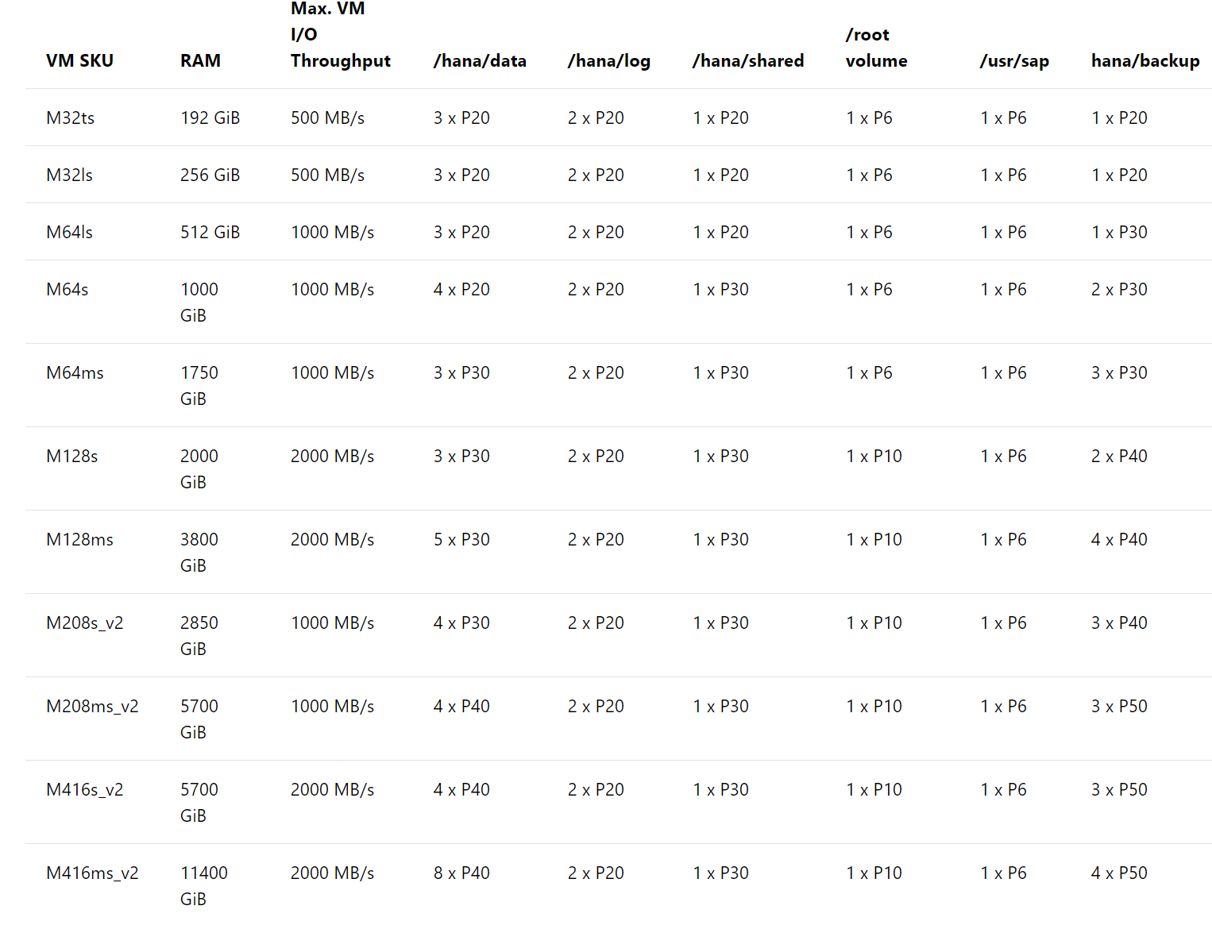
Premium Storage config to run HANA on M Series VM
Enable Write Accelerator
Link to documentation

Slide 13


S/4HANA HA in Availability Set and DR across Regions
Primary Azure Region
Secondary Azure Region
AvSet
AvSet
HANA Database layer (=SPOF)
HSR Sync on Linux Pacemaker Cluster
HSR Replication
AvSet
Blob storage for ASR
AvSet
SAP Central Services (ASCS) layer on Windows (=SPOF)
ASCS on Windows Failover Cluster
ASR Replication
ASCS on Windows Failover Cluster
AvSet
AvSet
SAP file share layer on Windows (=SPOF)
SOFS on Windows Failover Cluster
ASR Replication
SOFS on Windows Failover Cluster
AvSet
AvSet
SAP Application Server layer (= Non-SPOF)
SAP Logon Group
ASR Replication
SAP Logon Group

Slide 14
S/4HANA HA and DR across Availability Zones
Azure Availability Zone 1 (Active)
Azure Availability Zone 2
HANA Database layer (=SPOF)
HSR Sync on Linux Pacemaker Cluster
SAP Central Services (ASCS) layer on Windows (=SPOF)
ASCS on Windows Failover Cluster
SAP file share layer on Windows (=SPOF)
SOFS on Windows Failover Cluster
SAP Application Server layer (= Non-SPOF)
SAP Logon Group
SAP Logon Group

Slide 15
Additional Note (Design)
Key design components :
HANA System Replication, Windows/Linux cluster, Windows SOFS or Linux DRBD or Azure NetApp Files, Azure Site Recovery, VNET Hub & Spoke topology
Discuss following two HA/DR options and choose one
HA in an Availability Set and DR across Regions
DR replica can coexist with QA in the second Region
HA/DR across Availability Zones
Include network solutions as well
Add ExpressRoute for end user access and consider geo redundancy
Add Site-to-Site VPN for remote admin & monitoring
Don’t forget other components :
Blob storage for backup retention, jump box, DNS, patching, backup, monitoring, Cloud Witness or SBD Disk

Slide 16
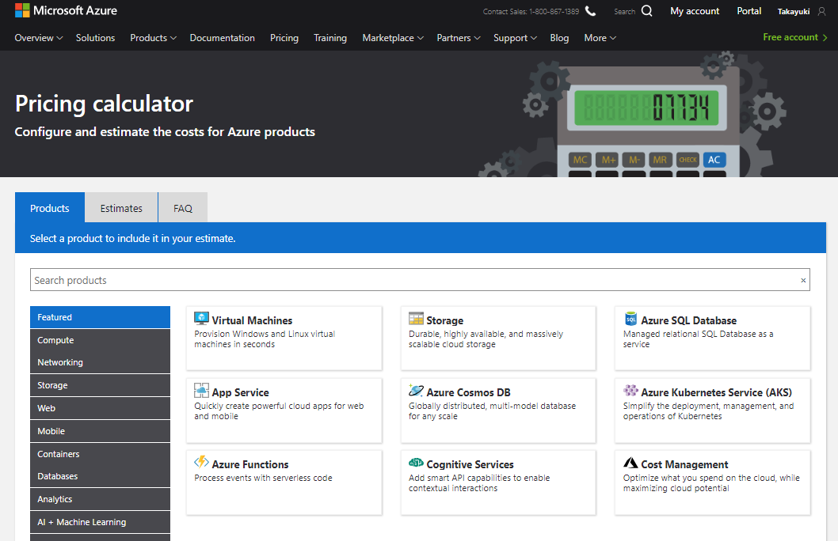
Azure Pricing Calculator

Slide 17
Additional Note (Pricing)
Use Reserved VM Instances option if it helps save costs
Consider best OS licensing option(s)
Common NOT to include Windows license costs because of AHUB
Can include Linux OS subscription costs from Azure marketplace
Create assumptions for ExpressRoute bandwidth
Make sure to include a minimum amount of Azure support
e.g. Azure Professional Direct

Slide 18
Customer needs and objections
Is the proposed solution fully certified by SAP ?
Does the proposal meet Contoso business continuity requirements. What if there’s outage on VM or storage. How can we restore from backup. How can we failover the landscape in case of a failover.
There’re legacy systems on-prem that need to interact with S/4HANA in cloud. How can we minimize impacts.
Can we change the size of the environment if sizing requirements change in future.
Is there anything not included in Calculator result ?
CFO is asking for cost saving even further. What can we do to optimize the cost. Any other options.

Slide 19
Step 2: Design and price the solution
Outcome
Design a solution and prepare to present the solution to the target customer audience in a 15-minute chalk-talk format.
Timeframe
50 minutes
Business needs (10 minutes) | Respond to questions outlined in your guide and list the answers on a flipchart
Design (30 minutes) | Design a solution for as many of the stated requirements as time allows. Show the solution on a flipchart
Prepare (10 minutes) | Identify any customer needs that are not addressed with the proposed solution Identify the benefits of your solution Determine how you will respond to the customer’s objections Prepare for a 15-minute presentation to the customer

Slide 20
Step 3: Present the solution
Outcome
Present a solution to the target customer in a 15-minute chalk-talk format
Timeframe
30 minutes (15 minutes for each team to present and receive feedback)
Directions
Pair with another table
One table is the Microsoft team and the other table is the customer
The Microsoft team presents their proposed solution to the customer
The customer asks one of the objections from the list of objections in the case study
The Microsoft team responds to the objection
The customer team gives feedback to the Microsoft team

Slide 21
Wrap-up
Outcome
Identify the preferred solution for the case study
Identify solutions designed by other teams
Timeframe
20 minutes

Slide 22
Preferred target audience
Business Development Manager (BDM) or Application Sponsor (CFO)
Funds projects & apps
Most interested in public cloud
Business Unit IT / Developers (Director of SAP Business Analysts, Director of SAP Operations)
Reports to BDM and is responsible for coding and testing apps
Big influencer of public cloud strategy
Central IT (VP of IT Operations)
Reports into CIO and responsible for operating datacenter
Concerned about shadow IT created issues: security/compliance, server sprawl, and lack of control

Slide 23
Preferred solutions
Azure VMs – HA in Availability Set and DR across Regions
Azure VMs - HA and DR across Availability Zones

Slide 24





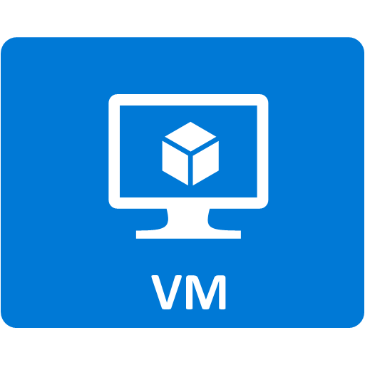













S/4HANA (1) : HA in Availability Set and DR across Regions
Azure Backbone network
Azure East US 2 Region
Azure AD
Azure VNET (Hub)
Azure VNET (Spoke – Prod)
Partner Admin Network
GW Subnet
Subnet Perimeter network
Subnet Prod AP + DB
Subnet Management
Cloud Witness
AvSet SOFS
AvSet ASCS/ERS
AvSet PAS Windows
AvSet HANA System Replication
Storage
S2S VPN
VNET Gateway
Backup
SAP Support
Web
SAP Router
Domain Controller, DNS,
Patch Server, Monitoring, Backup Jumpbox
Subnet Dev AP + DB
Site Recovery
Express Route Gateway
Customer Corporate Network
Azure NetApp Files
Azure VNET (Spoke - Others)
Subscription
MPLS+ Express Route
Azure Files
Azure West US 2 Region
Log Analytics
Azure VNET (Hub)
Azure VNET (Spoke – DR/QA)
Key Vault
VNET Gateway
Subnet QA/DR AP + DB
AvSet SOFS
AvSet ASCS/ERS
AvSet PAS Windows
AvSet HANA System Replication
SAP Router
DC, Patch Server, Monitoring, Backup etc
Power BI
Express Route Gateway
Logic Apps

Slide 25

S/4HANA (2) : HA and DR across Availability Zones
Azure Backbone network
Azure East US 2 Region
Partner Admin Network
Azure VNET (Hub)
Azure VNET (Spoke – Prod)
S2S VPN
GW Subnet
Subnet Peri-meter network
Subnet Management
Subnet Prod and QA
NFS share (Primary) Prod and QA
ASCS/ERS (Primary) Prod and QA
Active Zone
SAP Support
Web
Application Prod and QA
HANA (HSR Primary) Prod and QA
Availability Zone 1
Patch Server, Monitoring, Backup Jumpbox
SAP Router
Customer Corporate Network
ZR ER Gateway
ZR VPN Gateway
Availability Zone 2
MPLS+ Express Route
NFS share (Standby) Prod and QA
ASCS/ERS (Standby) Prod and QA
Application Prod and QA
HANA (HSR Standby) Prod and QA
Availability Zone 3
iSCSI Target (SBD Device)
Subscription

Slide 26


Baseline Knowledge for SAP as a Service on Azure
Icon | Name | Description
 | Region | An area within a geo that does not cross national borders and contains one or more datacenters.
 | Subscription | A customer's agreement with Microsoft that enables them to obtain Azure services.
 | Azure Active Directory (Tenant) | Azure Active Directory helps you manage user identities and create intelligence-driven access policies to secure your resources.
 | ExpressRoute | Direct Connectivity from customer network to Microsoft Enterprise Edge (MSEE)
 | Virtual Network | A network that provides connectivity between your Azure resources that is isolated from all other Azure tenants.
 | Subnet | A subnetwork or subnet is a logical subdivision of an IP network.
 | Network Security Group | NSG contains a list of security rules that allow or deny network traffic to resources connected to Azure Virtual Networks (VNet)
 | VPN Gateway | A specific type of virtual network gateway that is used to send encrypted traffic between an Azure virtual network and an on-premises location over internet.
 | ExpressRoute Gateway | A specific type of virtual network gateway that is used to send traffic between an Azure virtual network and an on-premises location over ExpressRoute/Direct Peering.
 | Virtual Machines | The software implementation of a physical computer that runs an operating system.
 | Azure Premium Storage and Managed Disks | Azure Storage offers a massively scalable object store for data objects, a file system service for the cloud
 | Availability Set | A collection of virtual machines that are managed together to provide application redundancy and reliability.
 | Availability Zones | HA and metro DR offering to protect from DC failures with independent power, cooling and networking.
 | Load Balancer Standard | ILB directs traffic only to resources that are inside a virtual network or that use a VPN to access Azure infrastructure. (Layer 4)
 | SBD Device /Azure Cloud Witness | Critical component to avoid split brain with Cluster/HA solution
 | HANA on Azure Large Instances | HANA tailored data center integration (TDI) certified server hardware infrastructure
 | HANA Large Instances Storage | HANA tailored data center integration (TDI) certified NFS storage infrastructure
 | High Availability Pair | two or more identical HANA large instances deployed in the same region and configured by the customer for system replication
 | Azure Backbone Network | Microsoft owned global fiber network linking all Azure datacenters
 | Regional Pairs | Regional protection within data residency boundaries

Slide 27
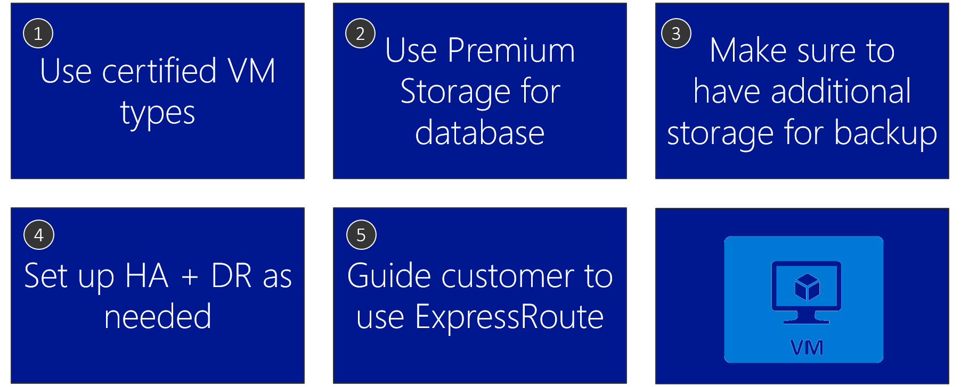
Azure VM design tips

Slide 28
S/4HANA on Azure : T-Shirt Pricing
If links don’t work copy them and paste to browser
# | S/4HANA DB Size | Cost Conscious or HA/DR | Estimated monthly Azure cost (USD) | Link to BOM
1 | 192GB | Cost Conscious | $5,568.48 | Link
2 | 256GB | Cost Conscious | $5,746.62 | Link
3 | 512GB | Cost Conscious | $7,630.41 | Link
4 | 1TB | Cost Conscious | $9,631.73 | Link
5 | 1.75TB | Cost Conscious | $11,551.01 | Link
6 | 2TB | Cost Conscious | $12,051.57 | Link
7 | 3TB | Cost Conscious | $17,971.85 | Link
8 | 4TB | Cost Conscious | $20,978.26 | Link
9 | 6TB | Cost Conscious | $29,892.95 | Link
10 | 192GB | HA/DR | $10,131.37 | Link
11 | 256GB | HA/DR | $10,266.94 | Link
12 | 512GB | HA/DR | $12,588.07 | Link
13 | 1TB | HA/DR | $15,739.16 | Link
14 | 1.75TB | HA/DR | $22,267.93 | Link
15 | 2TB | HA/DR | $24,006.33 | Link
16 | 3TB | HA/DR | $36,150.50 | Link
17 | 4TB | HA/DR | $41,375.19 | Link
18 | 6TB | HA/DR | $58,892.93 | Link
Note :
All options include Prod, QA, Dev, Storage, Management, Network, SUSE OS/support, Azure Professional Direct Support and full SAP certification
All options does NOT include software licenses of SAP, Backup, Monitoring and Windows OS (because of AHUB)
Cost conscious doesn’t include HA nor DR (single VM) | backup retention : PRD daily for one month (= x 31), QA and Dev twice per month (= x 2)
HA/DR include local HA in Availability Set with Standard Load Balancer and DR replica in another region | backup retention PRD daily for one month, monthly and quarterly for one year (= x 47), QA and Dev monthly for one year (= x 12)

Slide 29
Azure Pricing Tips
Estimate VM uptime and use Reserved Instances if uptime is > 30%
Check T-shirt pricing model
Use Windows Server as much as possible and apply AHUB
Make sure to have multiple options
Be clear with assumptions when quoting
Go live with Pay-As-You-Go and switch to RI later
1
2
3
4
5
6

Slide 30
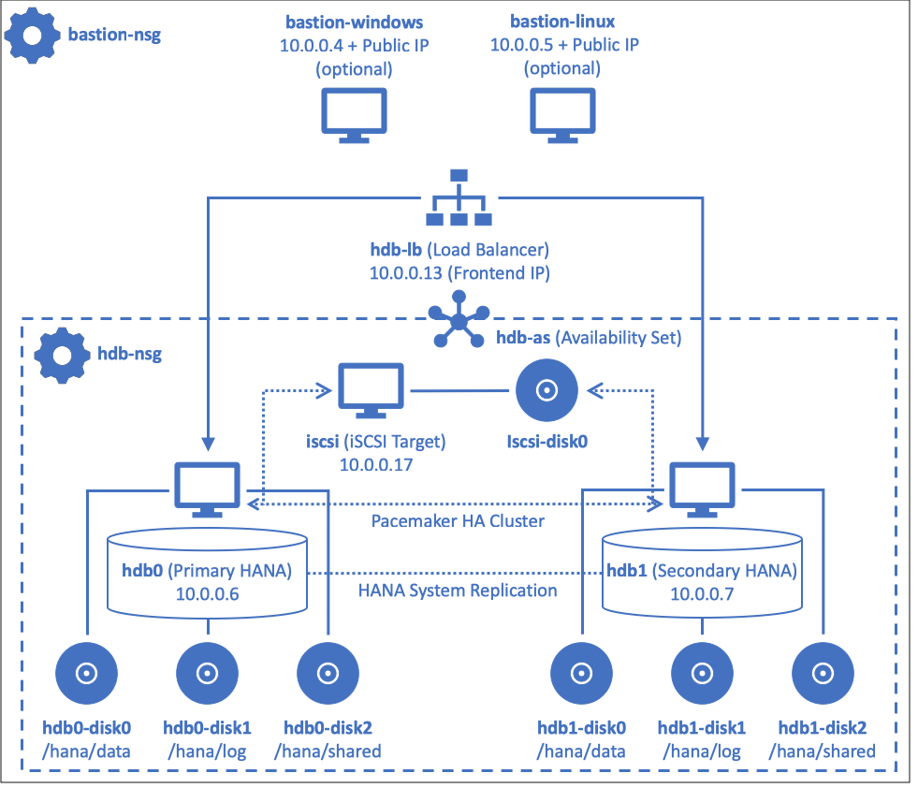
Automated deployment of HANA with Terraform and Ansible
Step-by-step Hands-on Lab guidance can be found here in Github

Slide 31
Roadmap
Azure Backup HANA support : Public preview
Azure Monitoring integration : Roadmap
Proximity Placement Group : Private preview
Azure NetApp Files : Certification for HANA (scale-up, scale-out) and support for Any DB in roadmap
Azure Files NFS support : Roadmap
Ultra SSD : Public preview, certification in roadmap
M416s, M416ms : Roadmap

Slide 32
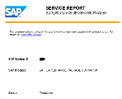
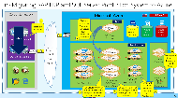
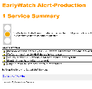

SAP on Azure - Cloud Assessment Session (= Architecture Design Session)
SAP on Microsoft Cloud
Cloud Assessment Session with Microsoft Global Black Belt Team
Inputs from customer
SAP Early Watch Report or HANA Sizing Report
or
Current hardware specifications (Server, storage, network)
Current software utilization (e.g. OS, DB, SAP, Non-SAP)
DB Metrics (e.g. DB volume)
Availability/security needs (Uptime, RPO/RTO, DR, Network)
Backup/Archival needs
Session Delivery (= 1 to 2 day)
Current SAP system analysis
Modernization scope & assumptions
Grand system design (e.g. Sizing, HA/DR/security, Performance, Automation)
Migration methodologies
Quote for Microsoft stack
Q&A
Deliverables
Written “To-Be” SAP architecture (Production, Non-Production)
ROI analysis
Planning of phased migration to minimize downtime and switching risks
Customer to share information on their current SAP/LOB systems
with Microsoft PEAT
Microsoft and Customer to discover how Microsoft Cloud and Technologies can best help modernize customer’s SAP/LOB systems
Customer to start to engage with their SI partner(s) to execute cloud modernization

Slide 33




Go Dos and Resources
Learn
SAP on Azure Website
SAP on MS Platform blog
SAP on Azure – SAP Community Wiki
SAP HANA/NetWeaver on Azure Documentation
HANA on Azure Large Instances Architecture
SAP on Azure reference architecture
Microsoft Partner Network – SAP on Azure
Whiteboard Design Session and Hands-on Lab (HANA and Any DB)
How Microsoft IT runs SAP
SAP on Azure case study videos
SAP HANA Academy
Open SAP
SAP on Azure Infopedia Product Hub (Internal)
SAP on Azure roadmap (Internal/NDA)
Battlecards (Internal)
SAP on Azure Tech Community Call (Internal)
Touch
SAP Cloud Appliance Library
SAP HANA on Azure SUSE Linux templates
SAP HANA on Azure ARM templates
Ask
SAP on Azure Yammer (Internal)
Contact SAP Technical Community saptalk@microsoft.com
Engage
Contact : Americas SAP on Azure CoE SAPGBBAMERICAS@microsoft.com, EMEA SAP on Azure CoE SAPGBBEMEA@microsoft.com or Asia SAP on Azure CoE SAPGBBASIA@microsoft.com

Slide 34
Latest SAP HANA on Azure content can be found at : https://github.com/Microsoft/MCW-SAP-HANA-on-Azure

Slide 35
S/4HANA HA in Availability Set and DR across Regions (DR Failover)
Primary Azure Region
Secondary Azure Region
AvSet
AvSet
HANA Database layer (=SPOF)
HSR Sync on Linux Pacemaker Cluster
HSR Replication
AvSet
Blob storage for ASR
AvSet
SAP Central Services (ASCS) layer on Windows (=SPOF)
ASR Failover
ASCS on Windows Failover Cluster
ASCS on Windows Failover Cluster
AvSet
AvSet
SAP file share layer on Windows (=SPOF)
SOFS on Windows Failover Cluster
ASR Failover
SOFS on Windows Failover Cluster
AvSet
AvSet
SAP Application Server layer (= Non-SPOF)
SAP Logon Group
ASR Failover
SAP Logon Group

Slide 36
S/4HANA HA and DR across Availability Zones (DR Failover)
Azure Availability Zone 1 (Active)
Azure Availability Zone 2
HANA Database layer (=SPOF)
HSR Failover
SAP Central Services (ASCS) layer on Windows (=SPOF)
ASCS Failover
SAP file share layer on Windows (=SPOF)
SOFS Failover
SAP Application Server layer (= Non-SPOF)
SAP Logon Group
SAP Logon Group

